Slide 1
What is encryption?
Pig Latin but harder
Has a key
Can be symmetric (one key) or asymmetric (public/private key pair)
Can be used to verify identify using an asymmetric handshake
TLS, AES

Slide 2
What is hashing?
One way transformation (if the algorithm is modern and secure)
Few collisions
SHA-256 (SHA2)

Slide 3
What is a relational database?
Stores data
Structures data based on relations between discrete atomic values
Allows for constraints and the modeling of relationships
PostgreSQL, SQLite

Slide 4
What is a Internet protocol?
Standardized set of requests and responses
Allows for interoperability between implementations
RFC documents to the Internet Engineering Task Force (IETF) and the Internet Society (ISOC)
IMAP – RFC 3501 and others (ex RFC 6851 for UID MOVE)
SMTP – RFC 5320

Slide 5
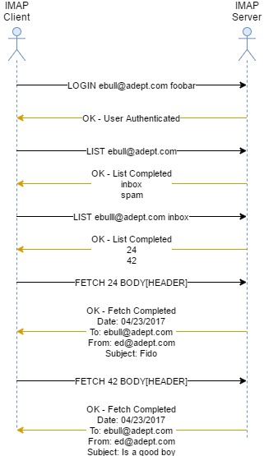
IMAP
Listing and retrieving emails
Deleting and moving emails
Creating, deleting, and renaming folders

Slide 6
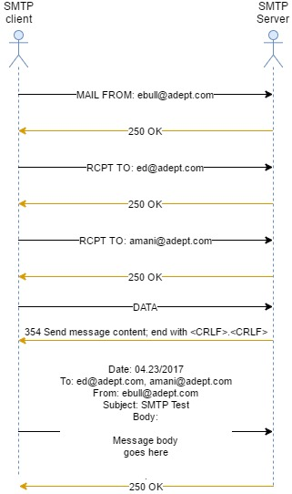
SMTP
Used for sending and receiving emails
Often used by mail servers to communicate to other mail servers, not just clients.

